Slide 1
Software Quality Assurance in Software Projects

Slide 2
What is Software
According to the IEEE Software is:
Computer programs, procedures, and possibly associated documentation and data pertaining to the operation of a computer system.
Software Errors, software faults and software failures ● Bug/defect/fault consequence of a human error o results in non-conformance to requirements o manifests as failure in running software

Slide 3
Terms for Software Failures
Depending on where you're employed as a software tester, you will use different terms to describe what happens when software fails. Here are a few:
Defect Variance
Fault Failure
Problem Inconsistency
Error Feature
Incident Bug
Anomaly

Slide 4
Error: A wrong action attributable to bad judgment, ignorance or inattention. or A misconception resulting from incorrect information.
Fault/ bug : The quality of being inadequate or falling short of perfection. Or Responsibility for a bad situation or event.
Failure: An event that does not accomplish its intended purpose. Or Loss of ability to function normally

Slide 5
SQA is a set of activities for ensuring quality in software engineering processes (that ultimately result in quality in software products). The activities establish and evaluate the processes that produce products.
Processes could be: Software Development Methodology Project Management Configuration Management Requirements Development/Management Estimation Software Design Testing etc

Slide 6
Once the processes have been defined and implemented, Quality Assurance has the following responsibilities:
Identify weaknesses in the processes correct those weaknesses to continually improve the process
SQA basically focuses on Process of the projects. It is a Prevention oriented. The Breadth of SQA is Organization wide. It relates to all products that will ever be created by a process or processes.
The activities of SQA are as follows:
Process Definition and Implementation Audits Training

Slide 7
Quality
Quality is a subjective term. Software quality will depend on who the customer is and the customer’s involvement in the overall software project.
Customer can be defined as the end users, customer acceptance testers, customer contract officers, customer management, the development organization’s management, accountants, testers, salespeople, future software maintenance engineers, stockholders, and so on.
Each type of customer who will be evaluating the value of the software application will have their own way of defining and measuring quality.

Slide 8
Definition of Good Design
Good software design is the design that incorporates the latest but proven technology, has a scalable structure, facilitates easy integration with other systems, and is flexible to allow incorporating changes in requirements.
Businesses always keep on expanding, thus any system deployed should also scale up nicely.
the application should be easily integratable with these myriad systems.
As Requirements keep changing very often ,the design should be flexible enough to take care of these changes in requirements.

Slide 9
Software bug occurs when one or more of the following rules are true
The software doesn't do something that the product specification says it should do.
The software does something that the product specification says it shouldn't do.
The software does something that the product specification doesn't mention.
The software doesn't do something that the product specification doesn't mention but should.
The software is difficult to understand, hard to use and slow.

Slide 10
Process and Product Quality
Process quality and product quality are closely related and process improvement benefits arise because the quality of the product depends on its development process.
A good process is usually required to produce a good product.
For manufactured goods, process is the principal quality determinant.
For design-based activity, other factors are also involved especially the capabilities of the designers.

Slide 11
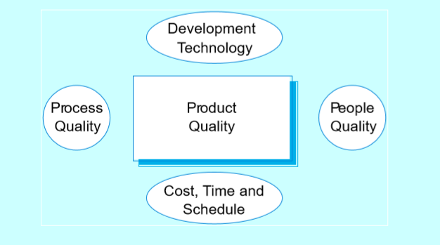
Software Product Quality Factors

